Slide 1
FuzzyTail
INTERNATIONAL HELLENIC UNIVERSITY
POLYTECHNIC SCHOOL
DEPARTMENT OF COMPUTER, INFORMATICS AND TELECOMMUNICATIONS ENGINEERING
M.Sc. in ROBOTICS
P202 – MACHINE INTELLIGENCE
FuzzyTail is a control system for an aircraft’s vertical flight angle using the rear control surface angle, based on fuzzy logic and implemented in MATLAB/Simulink
Semester Project on Fuzzy Systems of the Postgraduate Student
Kostelidis Iordanis

Slide 2
1^{ος} Ασαφής Ελεκτής (Default)

Slide 3
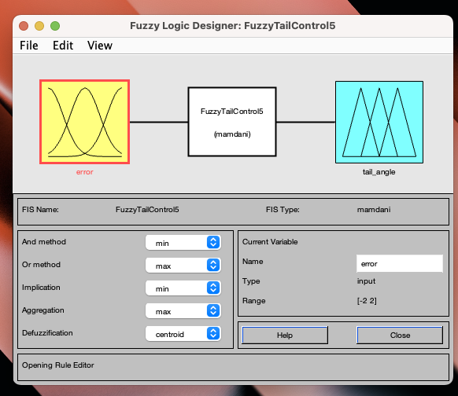

Slide 4
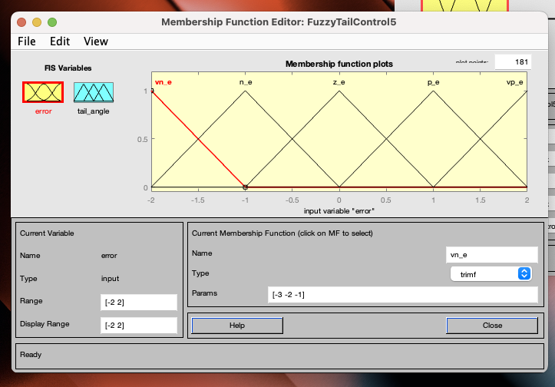

Slide 5
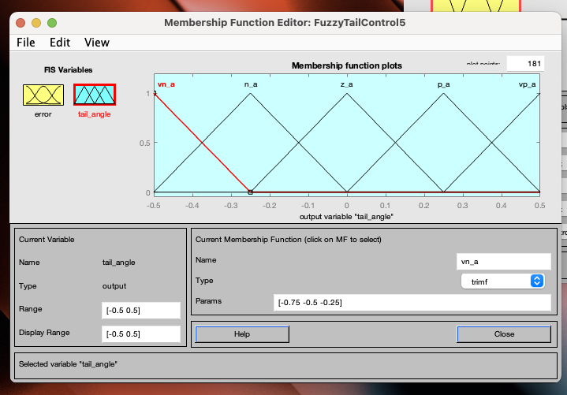

Slide 6
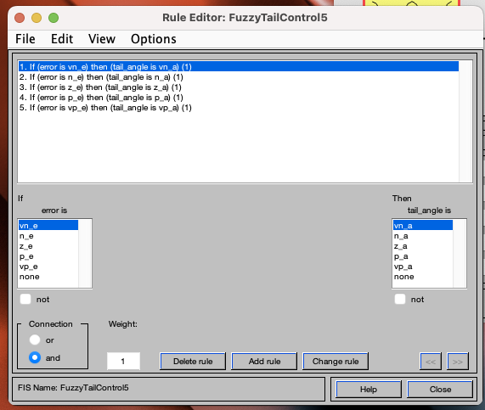

Slide 7
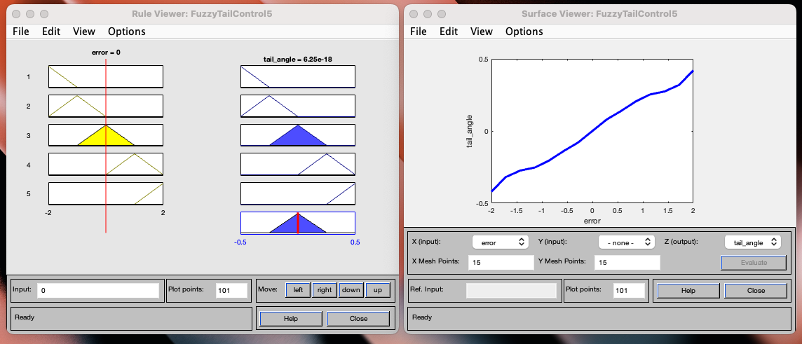

Slide 8
Σχέδιο στο Simulink

Slide 9
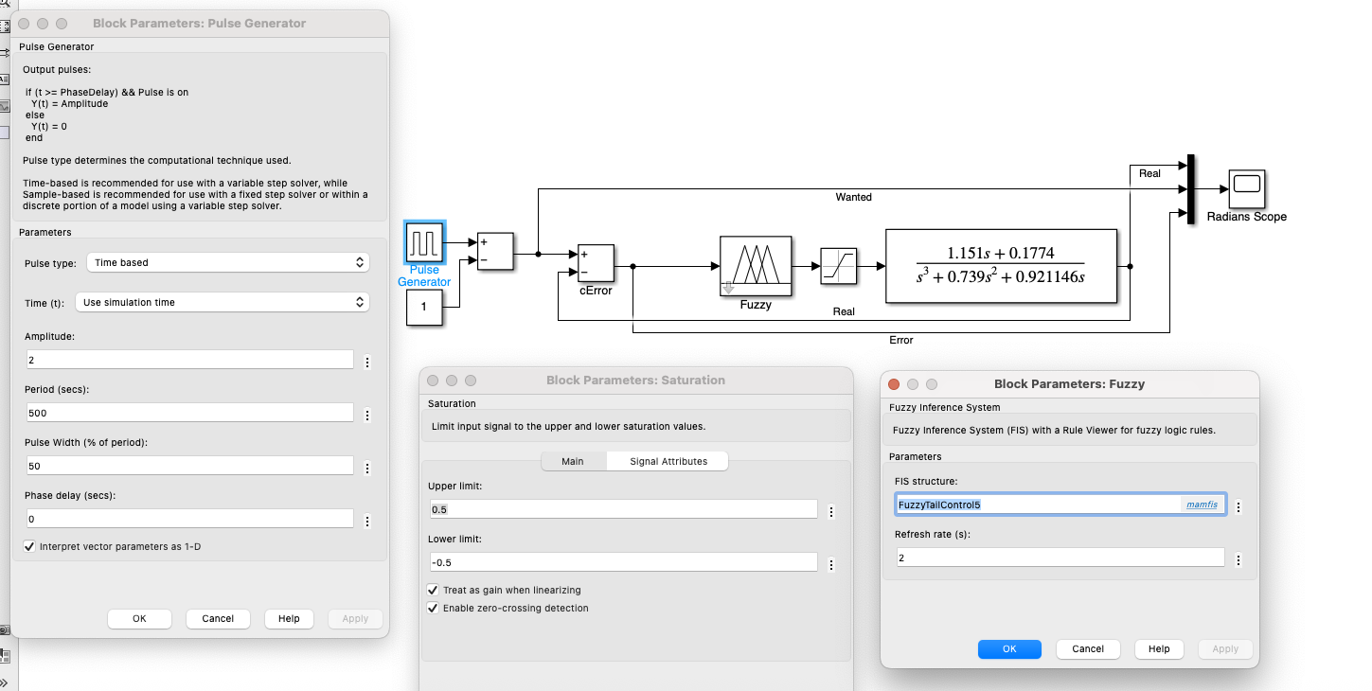

Slide 10
1^{ο} πείραμα, 1rad, 450s

Slide 11
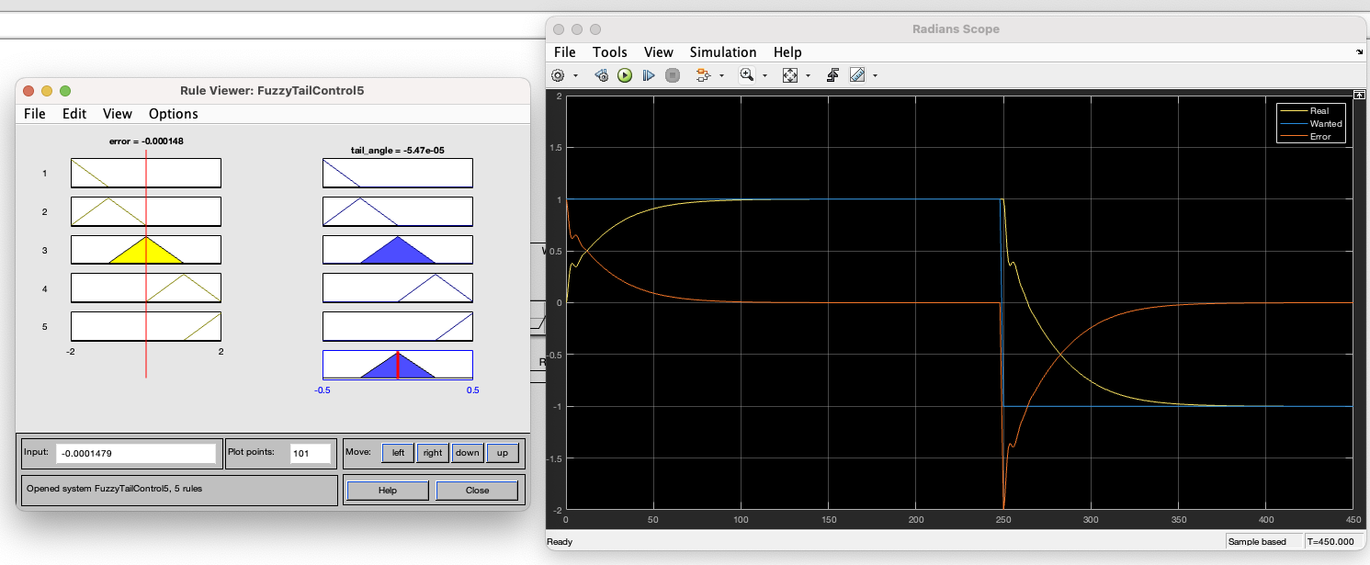

Slide 12
2^{ος} Ασαφής Ελεκτής

Slide 13
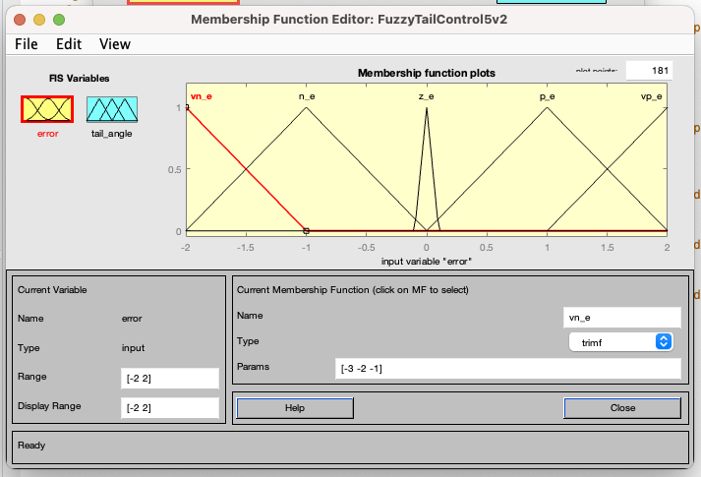

Slide 14
2^{ο} πείραμα, 1rad, 450s

Slide 15
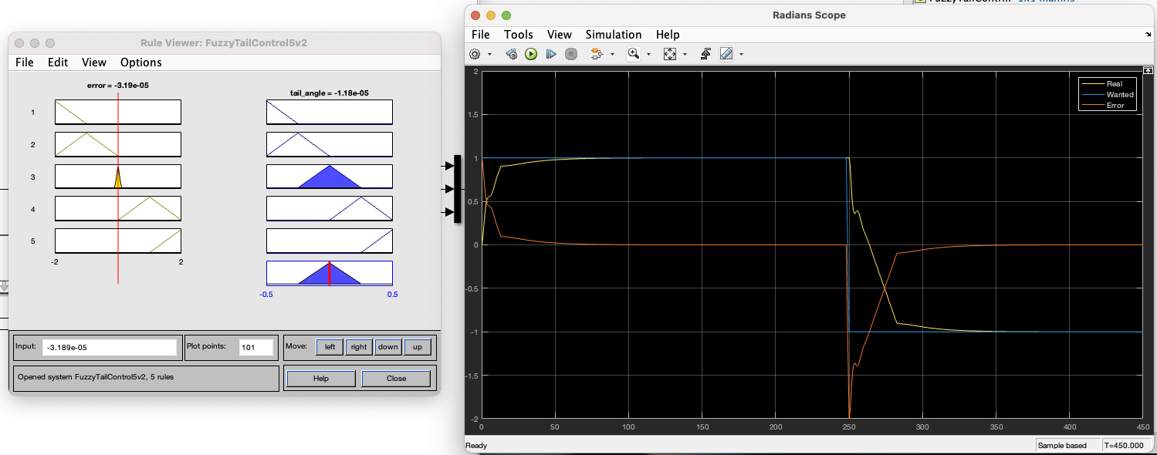

Slide 16
3^{ος} Ασαφής Ελεκτής

Slide 17
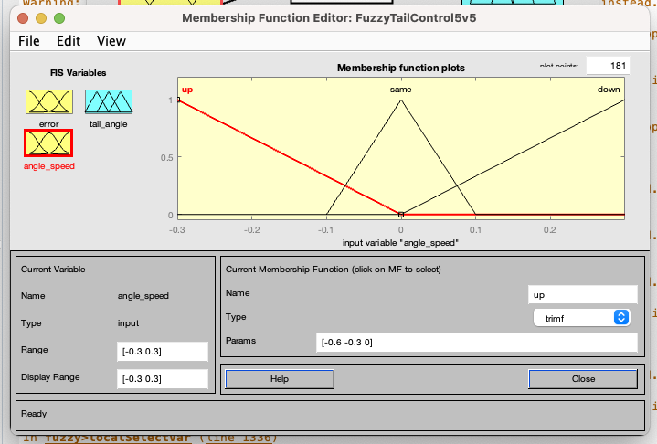

Slide 18
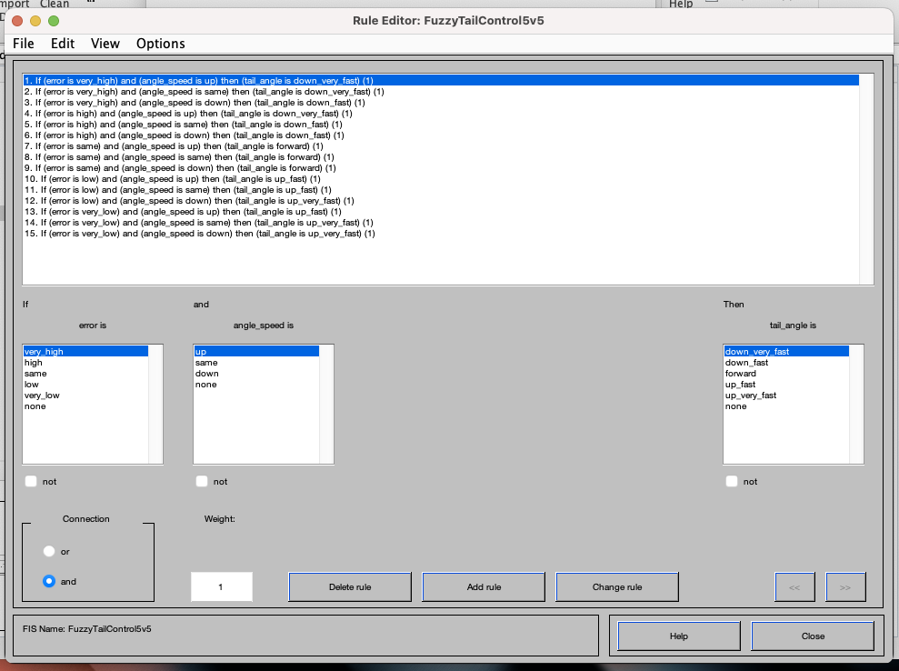

Slide 19
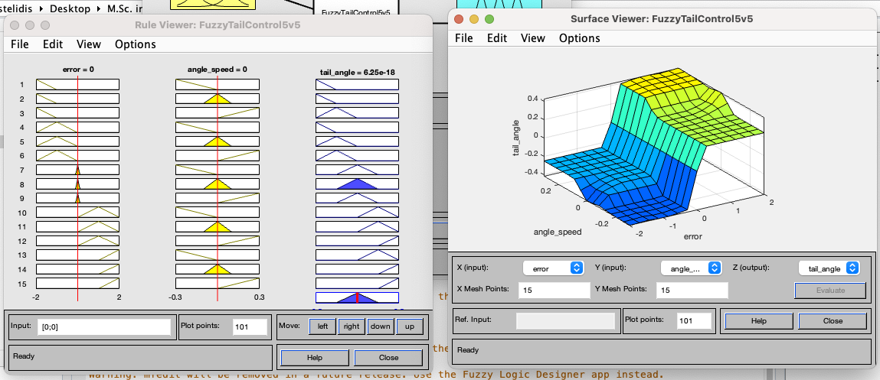

Slide 20
Σχέδιο στο Simulink

Slide 21
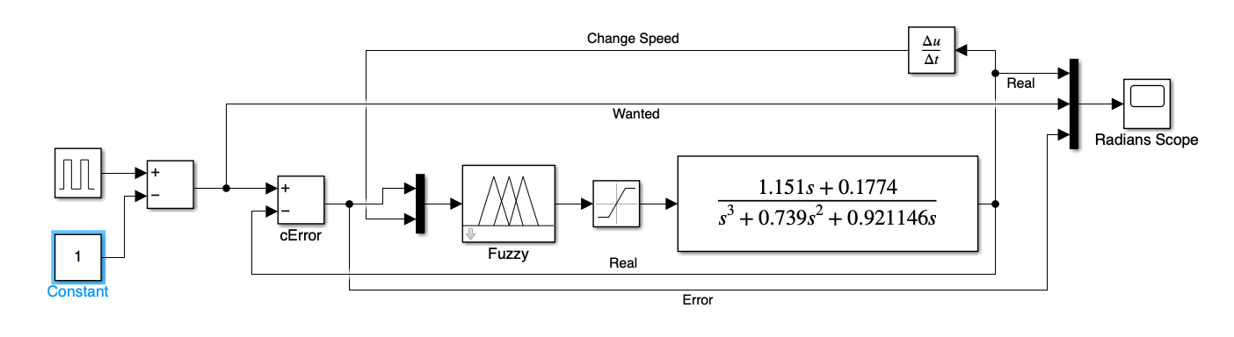

Slide 22
3^{ο} πείραμα, 1rad, 450s

Slide 23
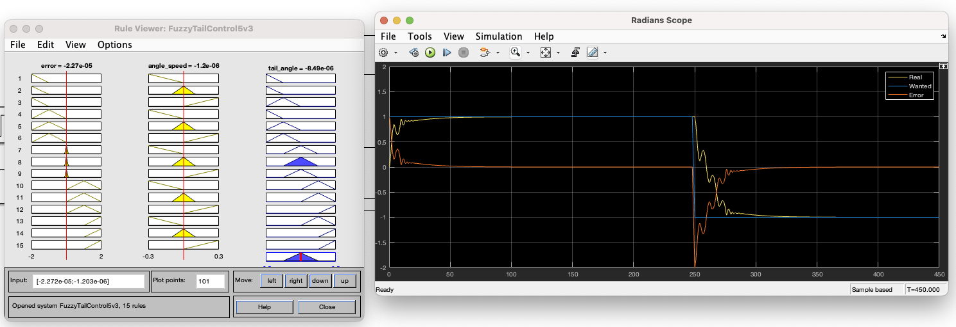

Slide 24
4-5-6^{ο} πείραμα, 1rad, 100s

Slide 25
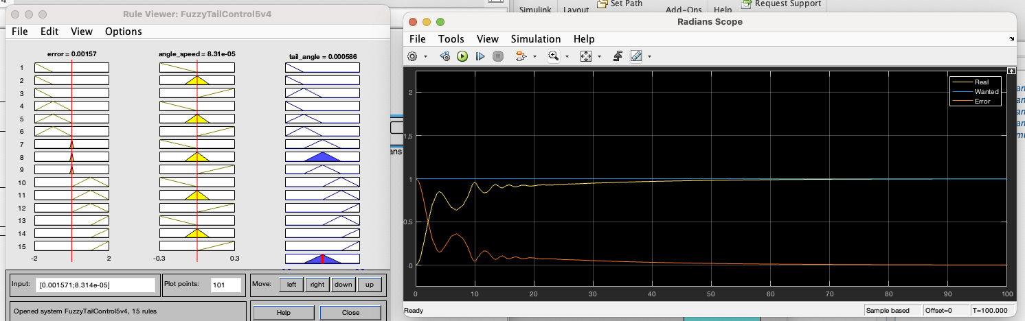

Slide 26
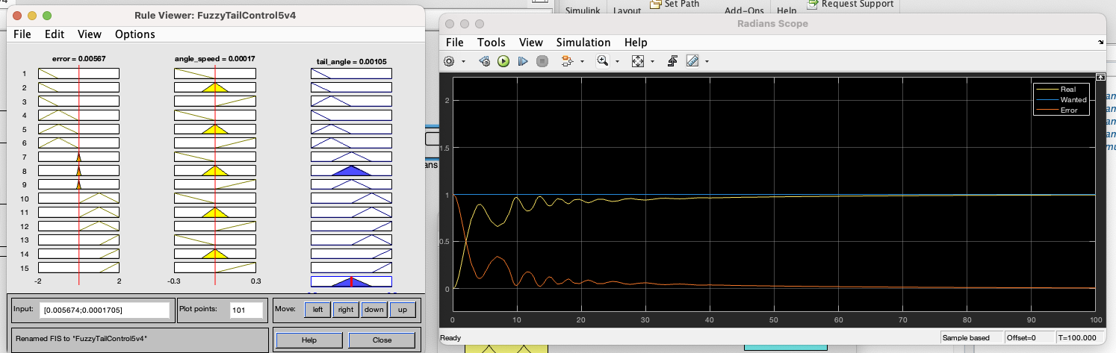
implication=prod

Slide 27
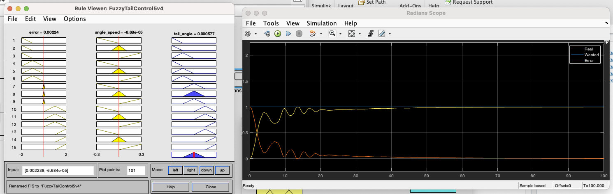
implication=prod, aggregation=probor

